Slide 1
HSRP Arctic Working Group
Team: Steve Carmel, Andy Armstrong, Lawson Brigham & Matt Forney (3 teleconferences)
Driving Forces for the U.S. Maritime Arctic:
~ Offshore Oil & Gas Development
~ Onshore Hard Minerals Development
~ Expanding Traffic along Russia’s NSR in extended summer navigation seasons
~ Continued need for seabed exploration of the outer continental shelf

Slide 2
Scenarios on the Future of
Arctic Marine Navigation in 2050
more demand
Arctic Race
Arctic Saga
High demand and unstable governance set the stage for an economic ‘rush’ for Arctic wealth and resources.
High demand and stable governance lead to a healthy rate of development, includes concern for preservation of Arctic ecosystems & cultures.
unstable
& ad-hoc
GOVERNANCE
stable & rules-based
RESOURCES & TRADE
Polar Lows
Polar Preserve
Low demand and unstable governance bring a murky and under-developed future for the Arctic.
Low demand & stable governance slow development in the region while introducing an extensive eco-preserve with stringent “no-shipping zones”.
less demand
AMSA/GBN Three Scenarios Workshops ~ 2007
The Future of Arctic Marine Navigation in 2020 & 2050

Slide 3
September 2007 Minimum Sea Ice Extent

Slide 4
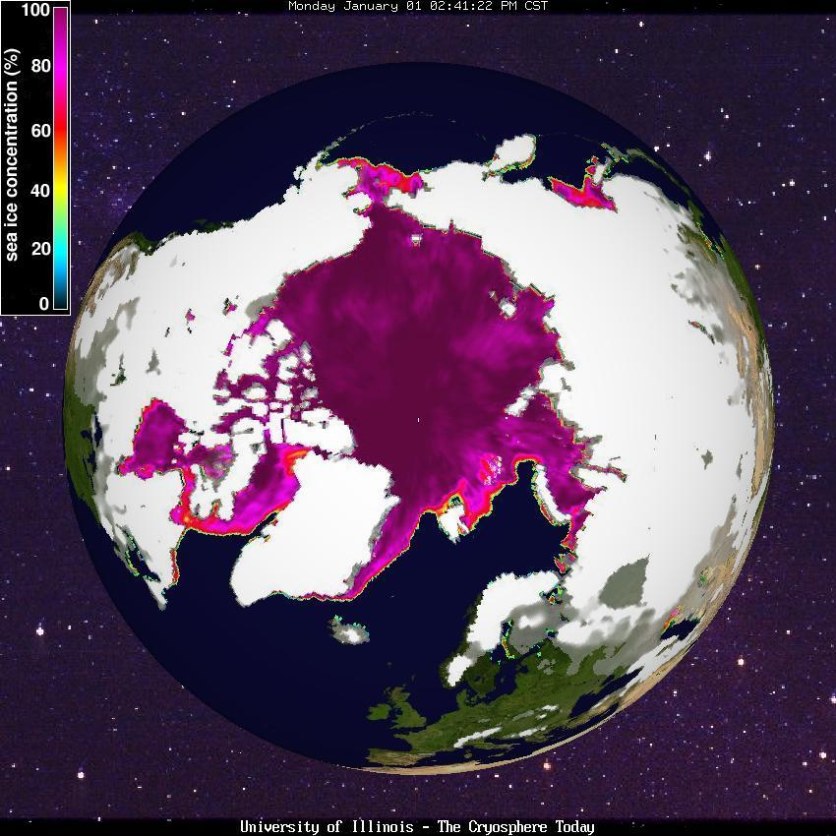
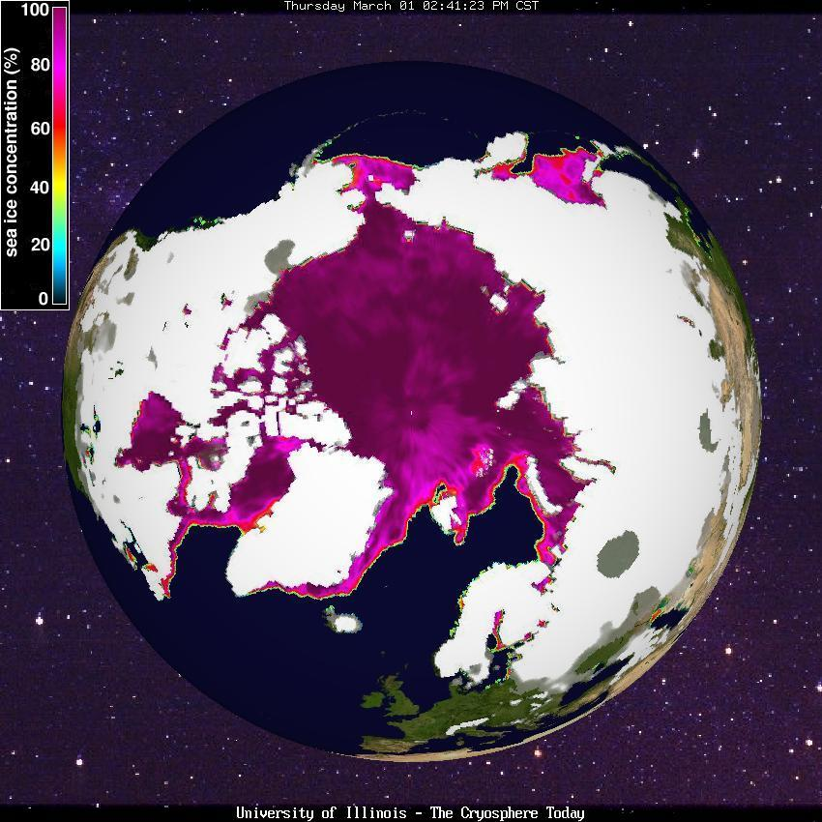
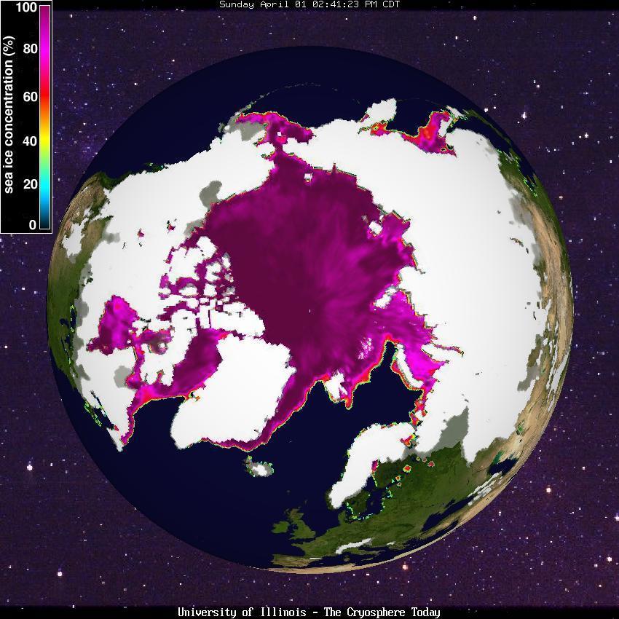
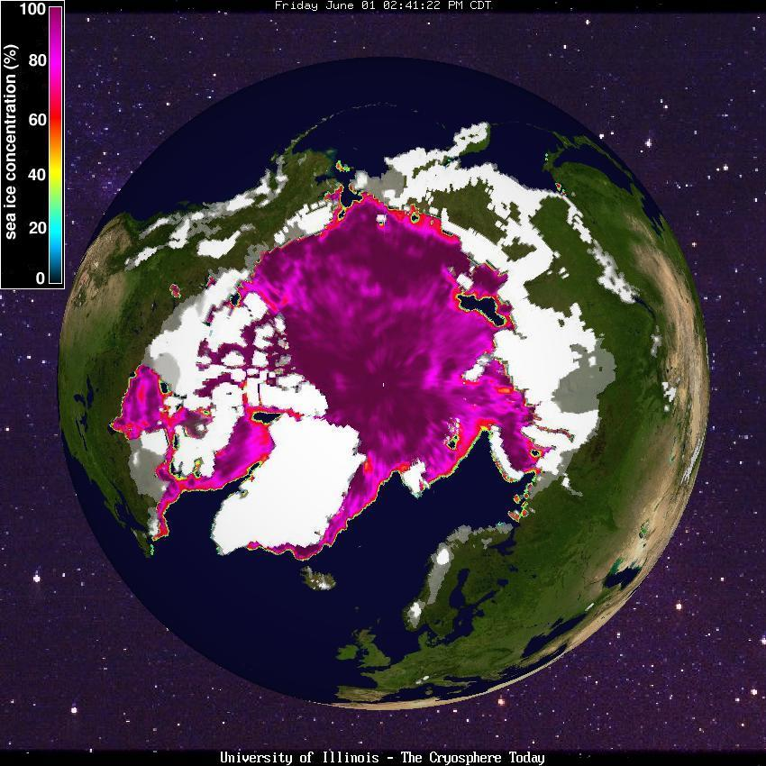
1 January 2007
1 March 2007
Winter & Spring Months 2007 (& 2012 !)
1 April 2007
1 June 2007

Slide 5
HSRP Arctic WG Key Issues:
Availability of New Hydrographic Surveying Assets?
New Monitoring & Surveillance Systems (AIS) ~ new & emerging use patterns to influence hydrographic planning & infrastructure needs.
Importance of integrated observations ~ more robust sea ice and current obs required in the U.S. maritime Arctic.
Increased complexity of the region ~ data needs increasing for IMO regs/designations , marine spatial planning, indigenous issues.
Adequate funding for Arctic marine infrastructure ~ need for public-private partnerships.

Slide 6
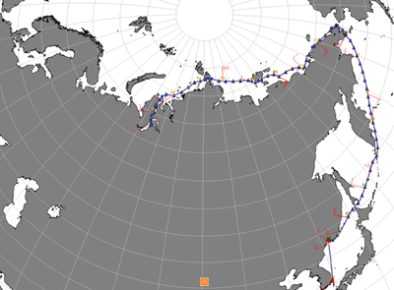
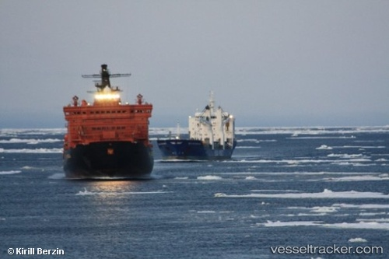
31 AUG
12 SEPT
7 SEPT
23 JUL
Summer Northeast Passage
2009 Voyages of Beluga Fraternity & Beluga Foresight

Slide 7
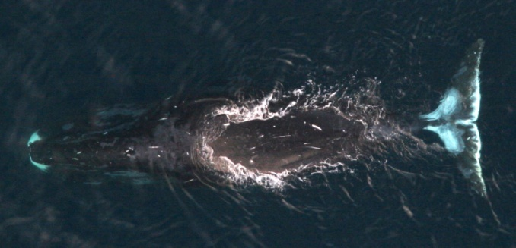
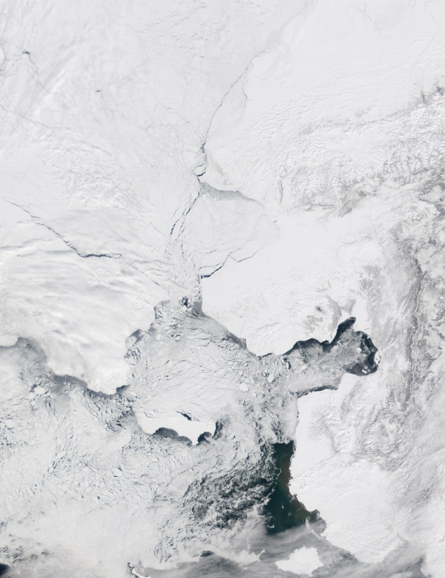
Bowhead Whale Migrations & Arctic Marine Operations
‘Wild Card’ Issue ~ Multiple Ocean Use Management & Enforcement
Summer
Spring
22 April 2002
Fall
Arctic Ocean Choke Point
Winter
Possible Arctic Shipping Routes

Slide 8
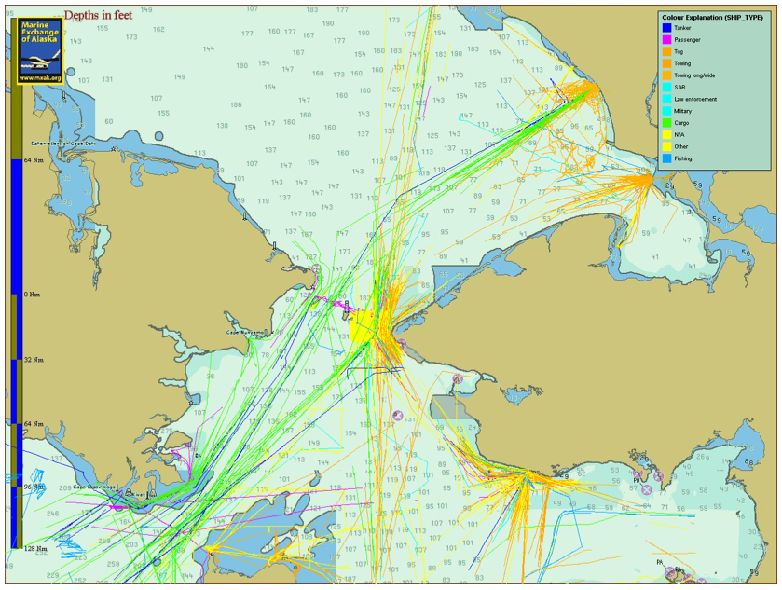
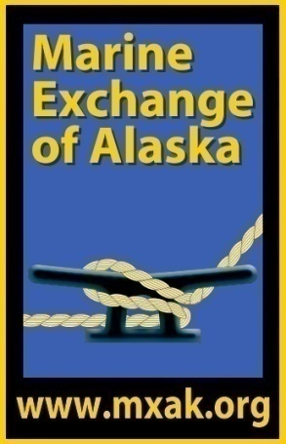
Bering Strait Region Shipping by Vessel Type:
1 May – 6 September 2010

Slide 9
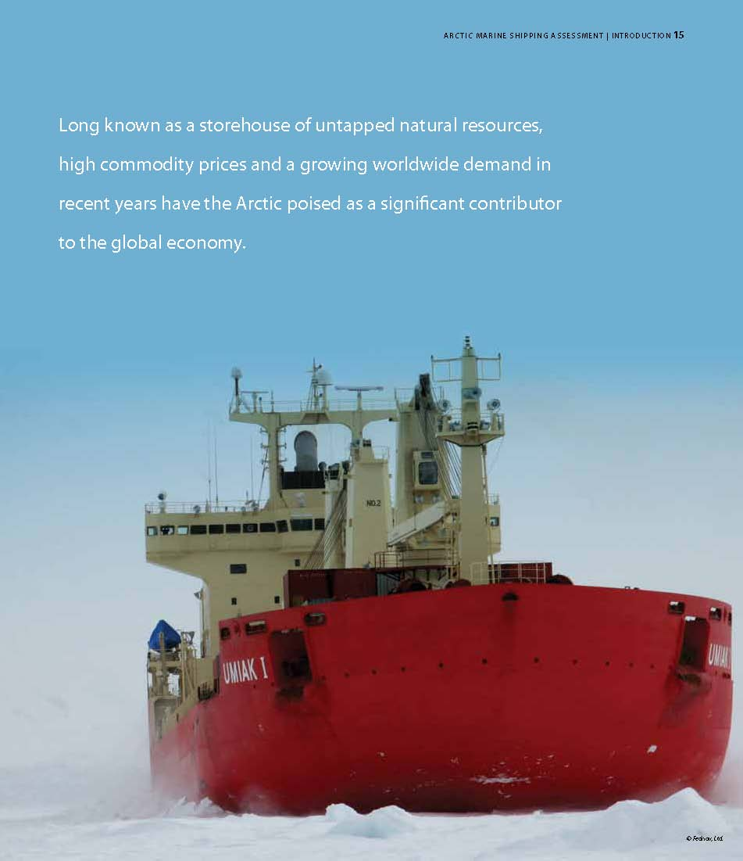
AMSA Recommendation from the Arctic States ~ IIIB. Arctic Marine Traffic System
~ “Comprehensive system to improve monitoring & tracking”
~ Near, real-time data shared among the Arctic States
~ Vessel ID, tracks, data fusion & analyses, detection of any anomalies

Slide 10
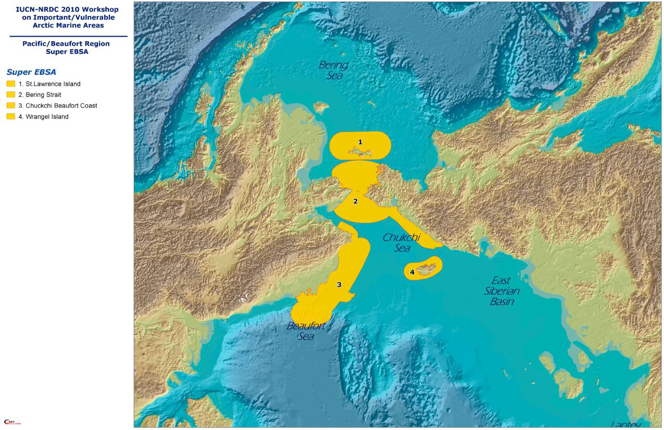
Super Ecologically & Biologically Significant Areas

Slide 11
Actions from the HSRP Arctic WG:
Explore new hydrographic platforms ~ R/V Sikuliaq (2014); CG & commercial assets.
Extend partnering with Shell (Aiviq)and new Arctic OAG offshore developers.
HSRP call attention to Arctic needs in upcoming GAO study on NOAA data collection systems.
U.S. delegation to IHO & Arctic Regional Hydrographic Commission ~ press for coordinated/collaborative efforts.
Standing Arctic WG ~ stakeholder surveys (?)

Slide 12
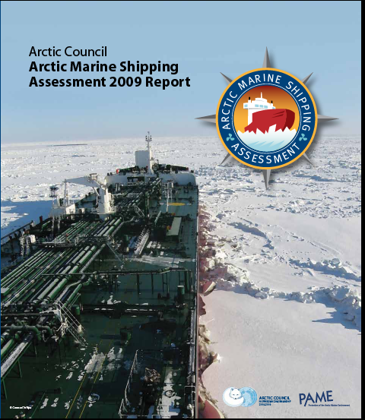
Arctic Ministers’ Approval 29 April 2009 ~ Negotiated Text
Table of Contents
• Executive Summary
with Recommendations
• Arctic Marine Geography
Climate & Sea Ice
• History
• Governance
• Current Use/Database
Scenarios to 2020 & 2050
• Human Dimensions
• Environmental Impacts
● Infrastructure
www.pame.is

Slide 13
AMSA 2009:
Baseline Assessment
Arctic Council Policy Document ~ Negotiated Text Approved 29 April 2009 ~
Strategic Guide (U.S. Framework for Environmental Protection & Marine Safety)
www.pame.is

Slide 14
Enhancing Arctic Marine Safety
Protecting Arctic People and the Environment
Building the Arctic Marine Infrastructure
AMSA RECOMMENDATIONS ~ THEMES

Slide 15
• Arctic State Linkages+++
• IMO Measures
• Uniformity of
Governance
• Passenger Ship Safety
• SAR Agreement++++
Enhancing Arctic Marine Safety
Protecting Arctic People and the Environment
Building the Arctic Marine Infrastructure
AMSA RECOMMENDATIONS ~ THEMES

Slide 16
• Arctic State Linkages+++
• IMO Measures
• Uniformity of
Governance
• Passenger Ship Safety
• SAR Agreement++++
Enhancing Arctic Marine Safety
Protecting Arctic People and the Environment
Building the Arctic Marine Infrastructure
• Indigenous Use
• Community
Engagement++
• Invasive Species
• Eco-Significant Areas++
• Oil Spill Prevention
• Marine Mammal Impacts
• Reducing Air Emissions
AMSA RECOMMENDATIONS ~ THEMES

Slide 17
• Infrastructure
Deficit
• Arctic Marine
Traffic System+
• Environmental
Response Capacity+
• Hydrographic, Met
& Ocean Data
• Arctic State Linkages++
• IMO Measures
• Uniformity of
Governance
• Passenger Ship Safety
• SAR Agreement++++
Enhancing Arctic Marine Safety
Protecting Arctic People and the Environment
Building the Arctic Marine Infrastructure
• Indigenous Use
• Community
Engagement++
• Invasive Species
• Eco-Significant Areas++
• Oil Spill Prevention
• Marine Mammal Impacts
• Reducing Air Emissions
AMSA RECOMMENDATIONS ~ THEMES

Slide 18
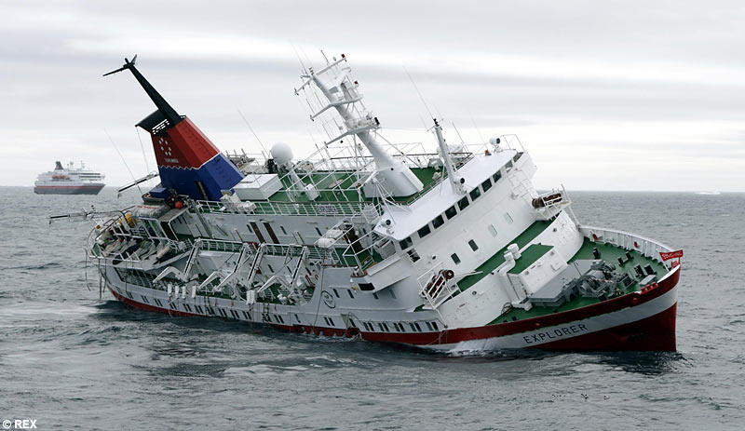
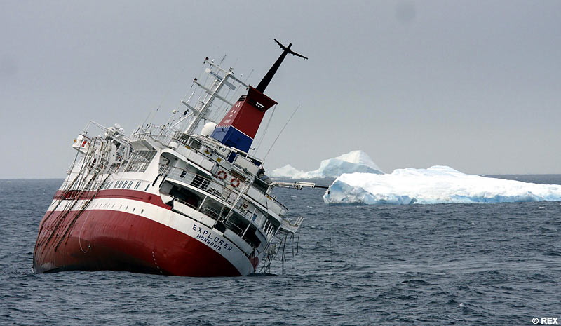
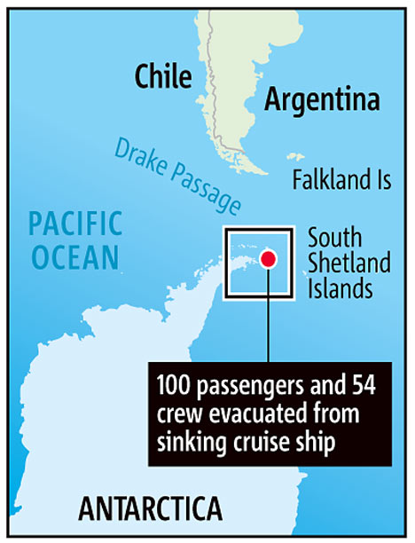
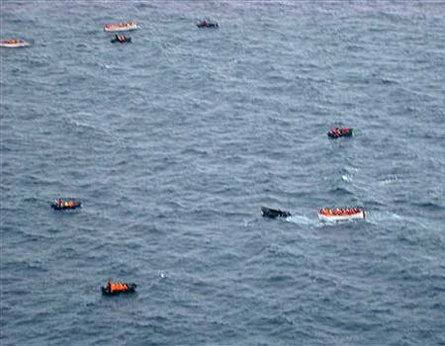
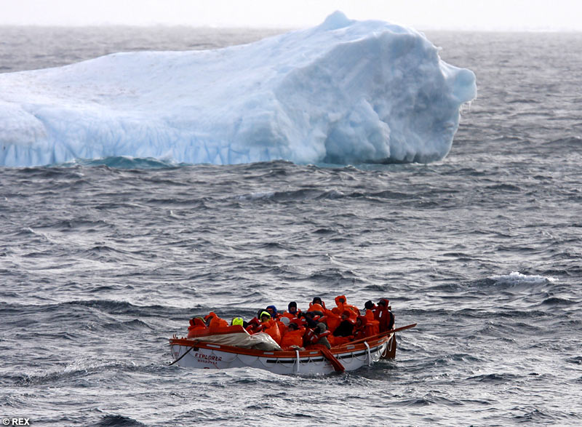
“Stricken cruise ship off Antarctic evacuated” MSNBC- 11/23/07
M/V Explorer

Slide 19
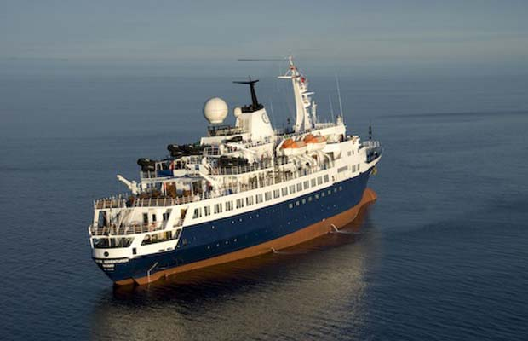
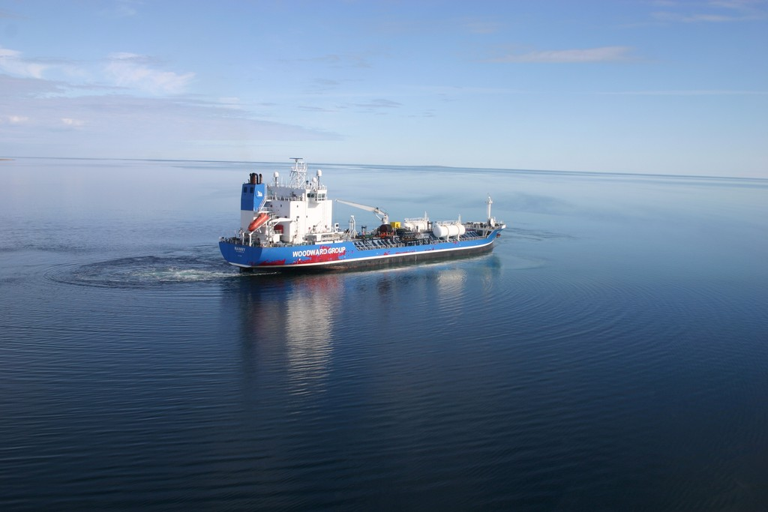
Groundings ~ Canadian Arctic
Aug-Sept 2010
M/V Clipper Adventurer
M/T Nanny

Slide 20
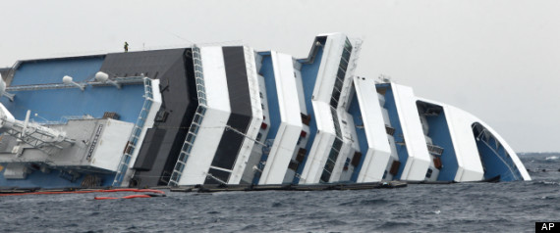
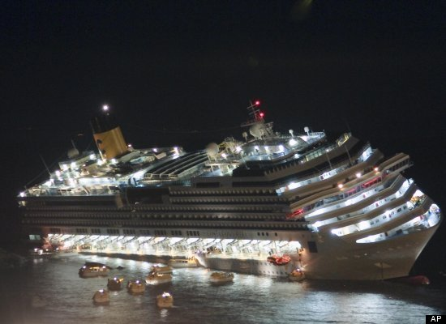
Costa Concordia Accident ~ Implications for Polar Cruising

